Slide 1


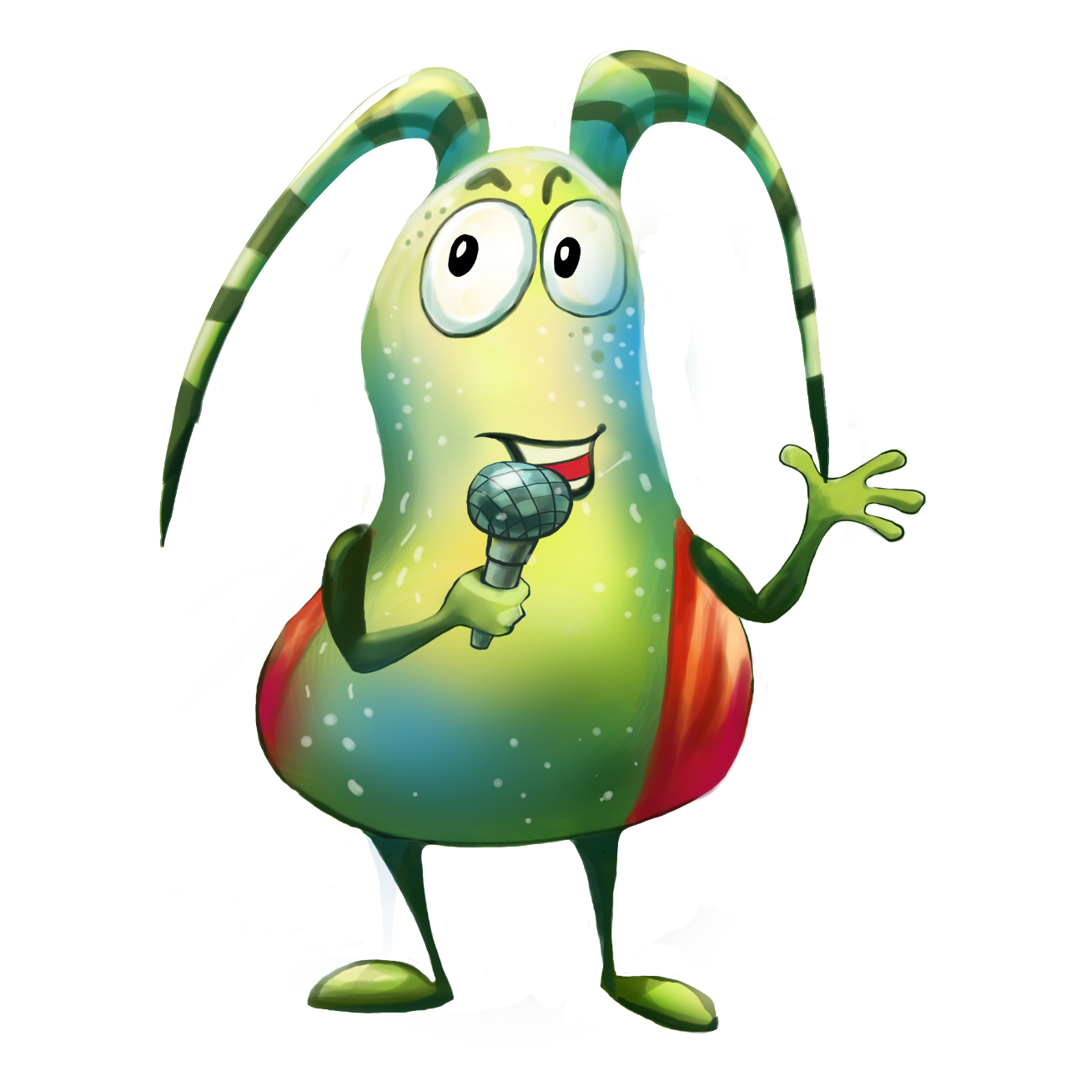
Misconceptions about software testing
Claudiu Draghia

Slide 2



About me
From Bucharest, Romania
5th time in Bulgaria
I started testing back in 2004
Last job Quality Manager @ Capgemini Romania
Currently on paternal leave
BrainForIT.com
Claudiu@BrainForIT.com
@claudiu_dra
Notes:
My name is Claudiu Draghia.. I am from…
But you can also find me on linked in, facebook and soon on udemy, I am now working on a class for how to solve the testing challenges.
Now that you know some things about me… I need to know something about you: how many of you are testers? Developers, BSs, SM or PJM?

Slide 3
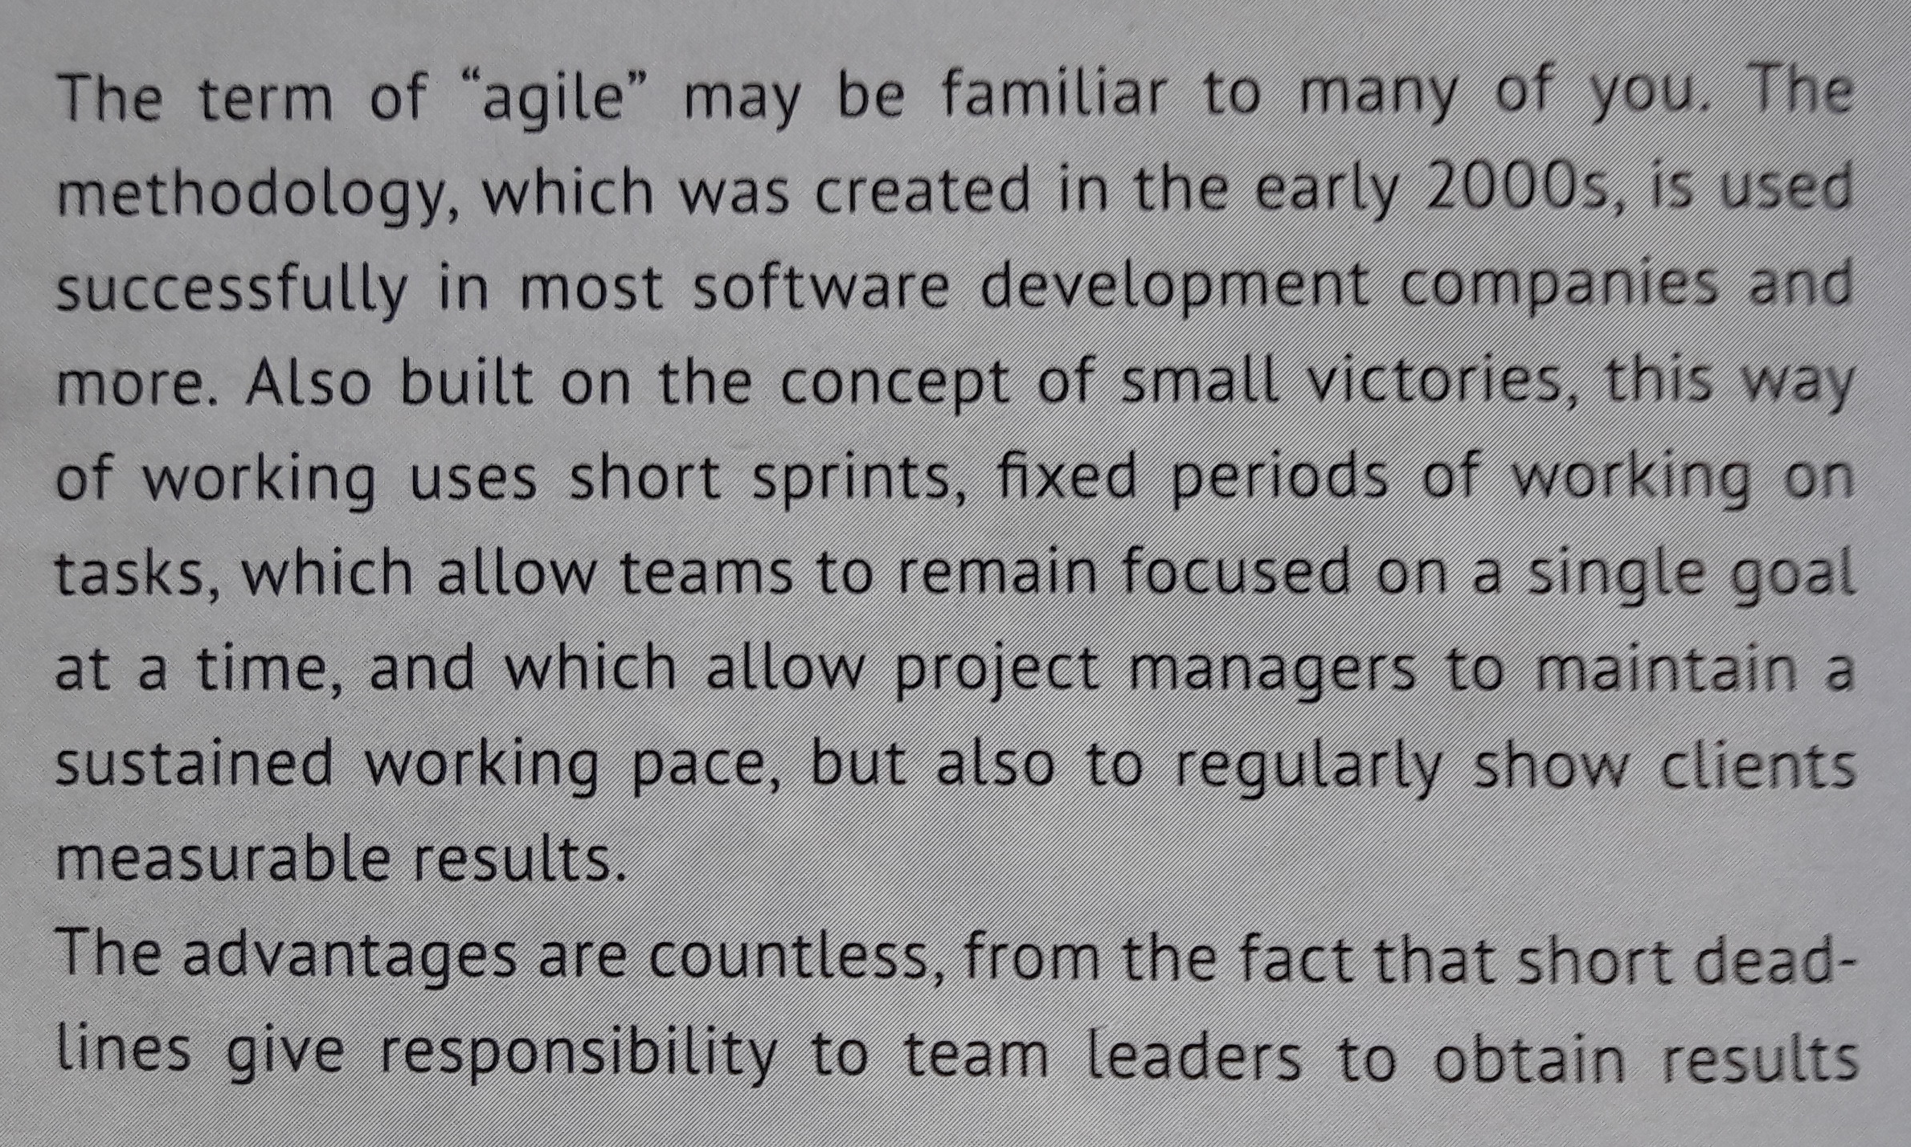
About misconceptions
A view or opinion that is incorrect because based on faulty thinking or understanding
7th Principle
Manifesto for Agile Software Development
The sponsors, developers, and users should be able
to maintain a constant pace indefinitely.
Notes:
a view or opinion that is incorrect because based on faulty thinking or understanding.

Slide 4







Why this talk?
Because I fight misconceptions about software testing
Testing community
NO !!
THREE
FOUR
The magic book
Feedback
of
I am right
Gatherings
SOFTWARE TESTING
Blogs
We see things differently and fail to understand different perspectives
We live in bubbles
Notes:
Why this talk?
Because I fight misconceptions about software testing . Because I like the truth and I really love this craft.
I have tried to created ways of dealing with some misconceptions about software testing. Ways that I will share with you during this presentation.
But why do misconceptions happened?
CLICK because there is no magic book of software testing. There isn’t a book that would give you everything you need to know about testing or how to test regardless of your context. As testers we have not even agreed on how many testing technique or approaches there are. The testing world is divided on certain topics because of different views of testing and sometimes because of financial interests.
And because there isn’t such a book we CLICK We see things differently and fail to understand different perspectives
And we live in bubbles within our projects, companies. We do not seek feedback form pears, read or have blogs, join a testing community or attend gatherings.

Slide 5
Why this talk?
Because I fight misconceptions about software testing
Misconceptions effect
    Make tester’s life harder
    Work more difficult
    Endless debates and discussions
    Hinder our understanding of the testing craft
    Promote illusions and wrong expectations about software testing
Notes:
Talking about misconceptions might leave you with a negative flavor. If this is the case you should turn that negativity into a opportunity to debate, change, learn and understand. If you do not agree with something that I will say, I really want you to come to me after the talk so that we can discuss further. I believe the best way to learn is from each other.

Slide 6
1. Everyone can test
12. It’s good & ok to test at the end of the Sprint
1.1 Tester’s salary should be less then a developer
  12.1 Testing should be done after the de development is done
2. Testing can be done under any circumstances
13. Testing is what testers do.
2.1 Anything can be tested
  13.1 Testing can be done in isolation by testers
3. Testing cannot be done without specifications
14. Testing is not a structured activity
3.1. Understanding requirements means reading them
  3.2 Tests are executable specifications
  14.1 Testing can find all the bugs
  14.2 Production bug: testers have failed
4. Manual vs. automated testing
15. Testers just have to be smart.
5. Automated testing
16. Learning testing
  16.1 Certifications are good or bad
  16.2 I will test better next time
5.1 Test automation pyramid
6. Quality assurance is testing
17. Testers are unsuccessful developers
7. Testers have to find bugs.
17.1 Testers should not learn how to code
8. Testers break software
18. Testing is an analytical activity.
  18.1 In order to properly test you need test cases
9. Testers with 5 years’ experience are senior.
19. Counting test cases/execution is a good thing
10. Don’t have enough time
20. What is software testing
11. Testers are the bearers of bad news.
21. I am a good tester
Notes:
Of 33 +1 statements
About performance and security testing

Slide 7
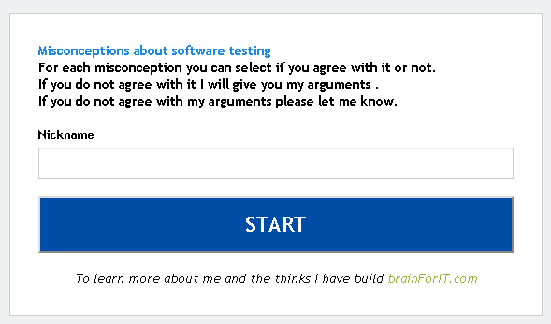
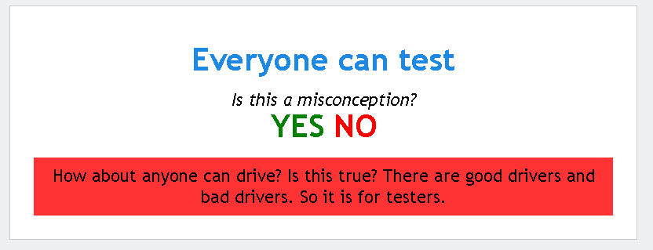

misconceptionsaboutsoftwaretesting.brainforit.com
Tester_that_knows_it_all

Slide 8


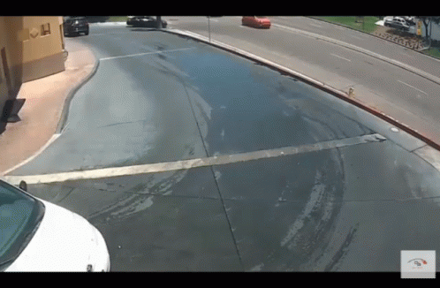

1. Everyone can test
1.1 Tester’s salary should be less then a developer
Saying that everyone can test is like saying everyone can drive
Notes:
Everyone can test. Saying that everyone can test is like saying everyone can drive. Remember this next time in traffic.
.

Slide 9
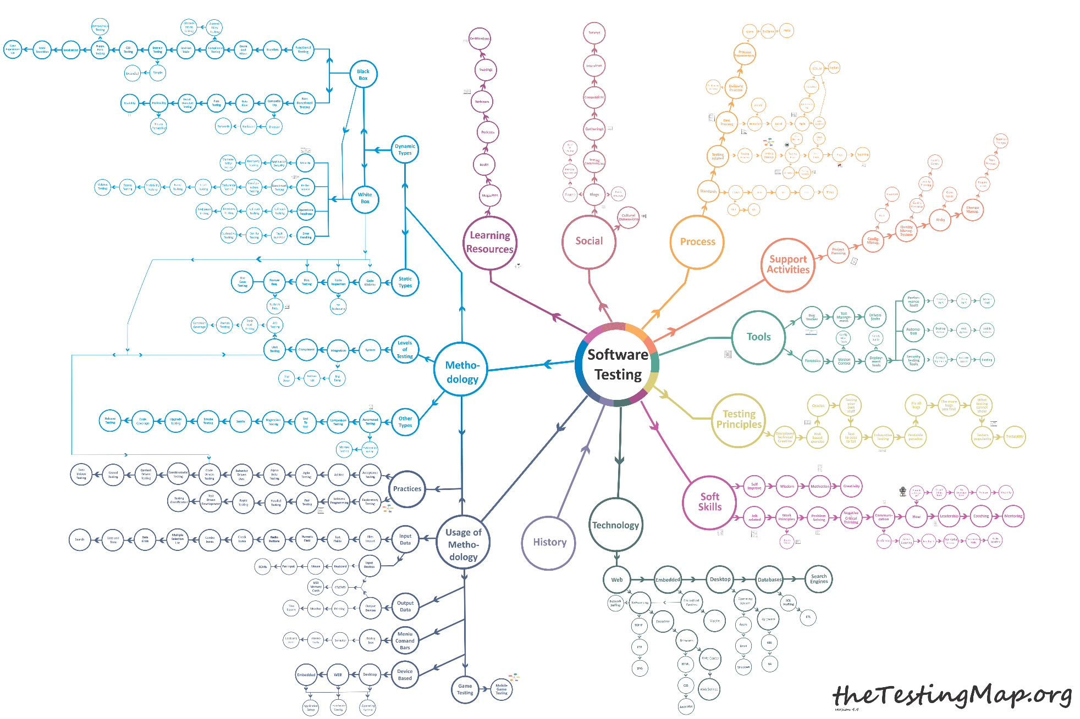
1. Everyone can test
1.1 Tester’s salary should be less then a developer
TheTestingMap.org
Notes:
Once I tried to answer a question what should a tester know: and I came up with this, the testing map. There are a lot of things a tester should know.
Every time I entered a argument about what a tester should know I pulled out the map. I always had it at the office, printed on a A3 paper.

Slide 10
1. Everyone can test
1.1 Tester’s salary should be less then a developer
Why does this happen?
Notes:
Why does this happen? You don’t hear people say as often everyone can be a developer?
One other aspect. Why do you think people in IT have this impression that everyone can test?
Could it be because testes are unable to properly explain what they are doing? Could it be that testers do not manage to create a clear picture about what testing is within the company?
Could it be that testers do not highlight the value of their work?

Slide 11
2. Testing can be done under any circumstances
2.1 Anything can be tested
testing
testability
Notes:
Testing can be done under any circumstances. It is true but the results won’t be the best. You need to remember that for testing to take place you need to have testability. If there is no testability there is no testing.
What does testability mean? Let me introduce you to a friend of mine:

Slide 12
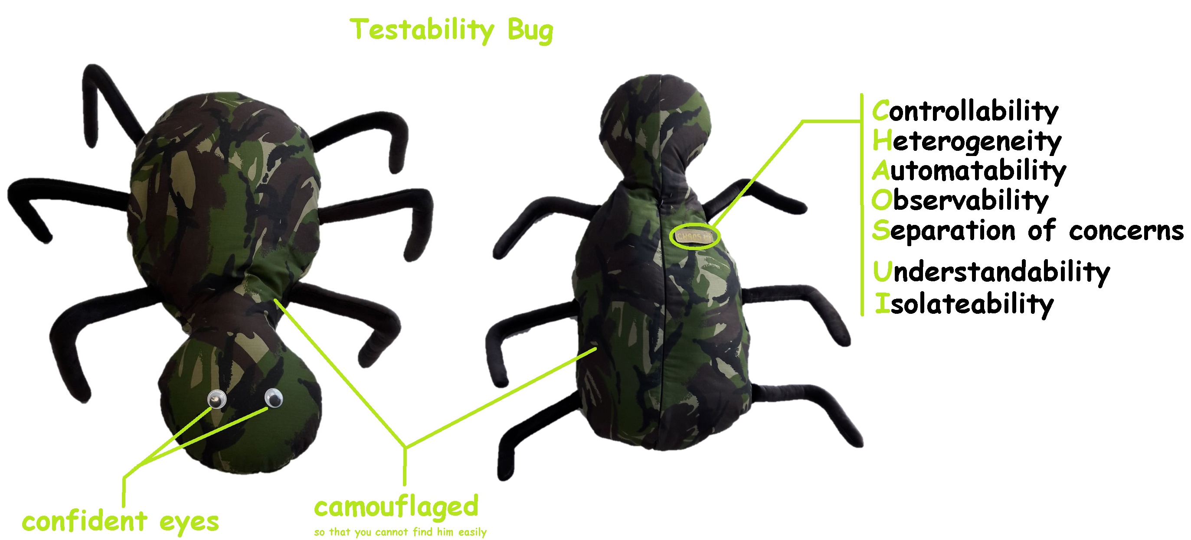
2. Testing can be done under any circumstances
Anything can be tested
testing
testability
As a tester you use them
bugs.brainforit.com
Notes:
His name is CHAOS UI, he is a testability bug.
His name is a acronym for what the main components of testability:
He appears when you can not properly test. He almost always appears IN PRODUCTION.
If want to see how other bugs look like go to bugs.brainforforit.com and there you will find chaos and 3 more bugs: the security, performance and the feature bugs.

Slide 13
2. Testing can be done under any circumstances
Anything can be tested
testing
testability
Testability is a team’s approach
It should not be a accident but a conscious decision
Testability is the root cause of many production bugs and a lot of time is spent reproducing them
Notes:
Before we move on to the next misconception a few words about testability.
Testability is a team’s approach
It should not be a accident but a conscious decision
Testability is the root cause of many production bugs and a lot of time is spent reproducing them.
What do you think is the worst bug? A production bug? Well I believe that the worst bug is a production but that you cannot reproduce.

Slide 14
3. Testing cannot be done without specifications
3.1 Understanding requirements means reading them
  3.2 Tests are executable specifications
The outcome can be determined by the
  Nature of the product
  Tester’s knowledge of the domain
  The skills and professionalism of the tester
  The availability of required resources
  By the approach you take: exploratory testing
simultaneous learning, test design and test execution
Notes:
I believe formal specification are not that important, what it is important is for you to know what problem the software must solve…
The outcome of not testing with formal specification is determined
Nature of the product
Tester’s knowledge of the domain
The skills and professionalism of the tester
The availability of required resources
By the approach you take: exploratory testin

Slide 15
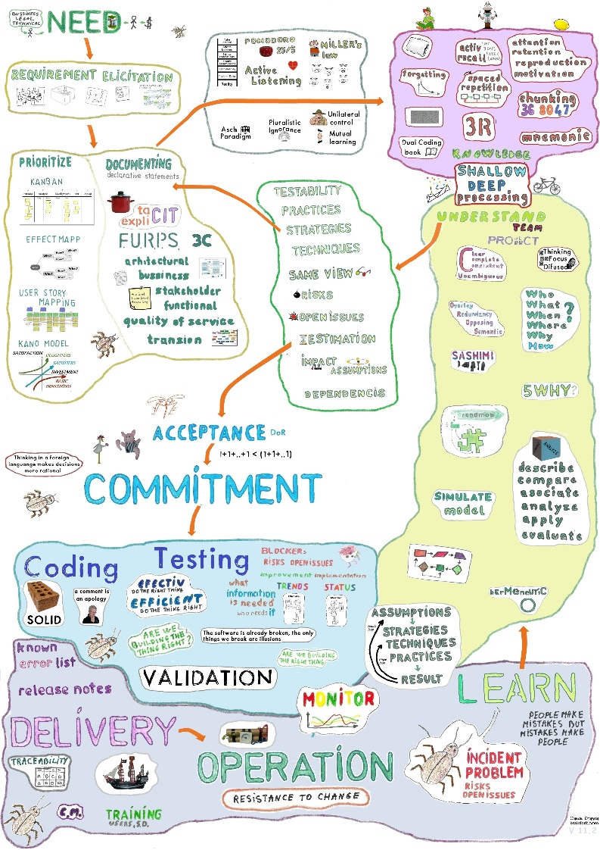
3.1. Understanding requirements means reading them
Critical Thinking Questions
Sashimi
Simulate and Model
Cubin
Drawing Diagrams and Flows
reviewrequirements.brainforit.com
Notes:
Understanding requirements means reading them. In order to understand something, it is never enough to read it. You need to understand it. For this there are techniques that you can use. Techniques like: Critical Thinking Questions, Sashimi, Simulate and Model, Cubin, Drawing Diagrams and Flow….
This is a skechnote that I build in odder to clarify for myself how to review and understand requirements.

Slide 16
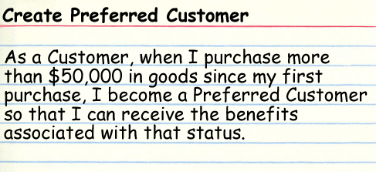
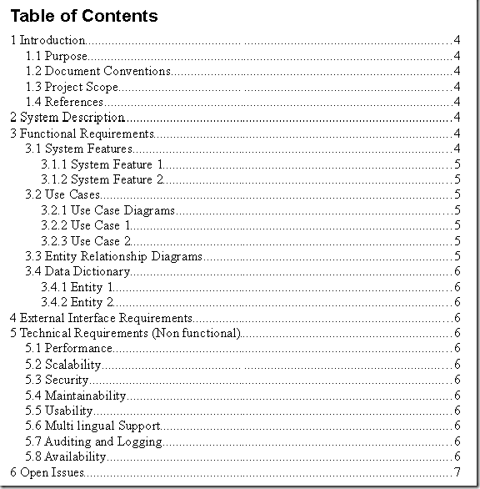
  3.2 Tests are executable specifications
Positive tests
Scenarios
+
Valuable information
DoD
Negative
Security
Performance
Test Claims

Slide 17


4. Manual vs. automated testing
Notes:
All testing is manual. You do not hear programmers say manual programing!!!
It is done with the hands in the same way writing programs is done with the hands.
Manual is not the proper word that illustrates all the brainstorming and thinking activities that roper software testing requires.
Manual has a “not so smart” appeal to it. As Michael Bolton puts it: “we help to cheapen and demean the craft” by using the manual next to testing

Slide 18
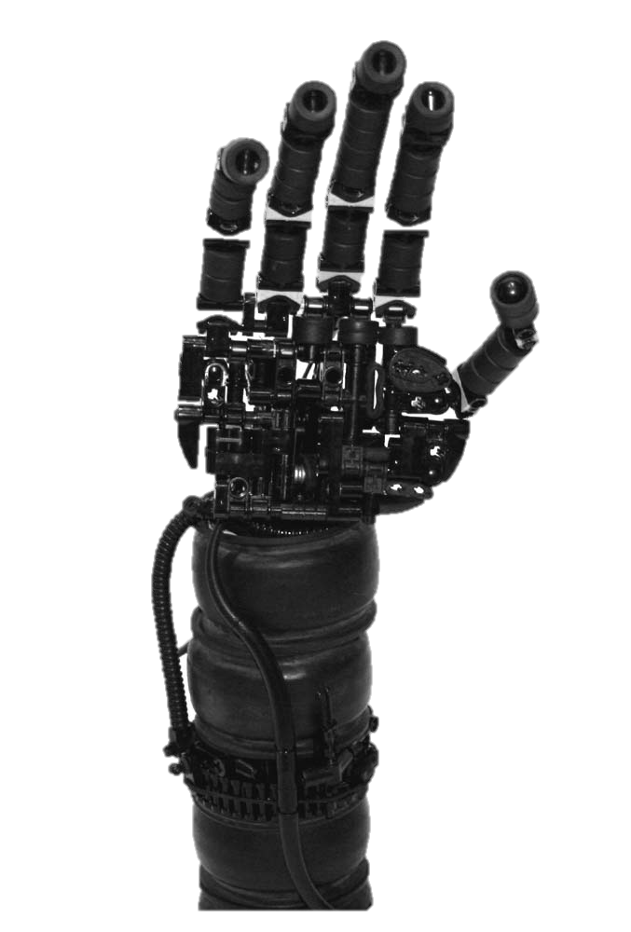
4. Manual vs. automated testing
Notes:
Since we talk about misconceptions most people believe that automated testing is like a robotic arm

Slide 19

4. Manual vs. automated testing
Notes:
When in fact, more often, is just a grabbing tool
Let’s move to the next misconception so that I can clarify this further:

Slide 20
5. Automated testing
automation
1. Do a test
Not everything / only specific checks
2. Decide to automate it
3. Use a toll to automate the execution
all checks have to be specified
no other check is done beside the specified ones
4. Debugging in case of failure
5. You update or remove it
Notes:
First of all is called test automation.
You do a test, then might decide to automate it, you use a toll where you specify what checks to be done (no other check will be done), then you debug it in case of failure and at some point in time you update or remove it.
So it is not even test automation . It is check automation. You instruct a program to check for certain things. The program will never say: this is odd… I’ll check this also. It will do, and only do, the things you instruct it to do. (and you instruct it to do what you have “manually” done before)

Slide 21



5. Automated testing
automation
Cost of testing
Number /
importance of defect
Under test
Over test
time
Notes:
For some testers test automation is what a scarecrow is for birds, …
Automation has this appeal of being after our Job, but remember it is not automated testing, not test automation the proper description is check automation.
Let me give you a proper reason to be scared of check automation
Please have a look at this chart with the Cost of testing and number/importance of defects. There is a optimum amount of testing that you should do. Too little and you under test, to much and then you over test.
If it is the case, you should be able to automate those checks the allow to optimize the testing done. If you cannot do this then you are one skill short.
I have been working in It for almost 14 years. I have never heard of a tester being laid off because the testing team managed to automated check and he was not needed anymore. What I have heard of was testers being laid off because they were unable to automated checks that would improve testing.
Let me give you a example of real job automation.

Slide 22

5. Automated testing
automation
1970 - 250 million tellers
2017 - 500 million tellers
Notes:
Do you know what ATM stands for?
Automated teller machine. Before they were invented, in order to get money from a bank a bank employee, a teller, would identify who you are and give you the amount requested.
They appeared since the 70s and threatened to make human bank tellers extinct
But if you look at the number of tellers. It has doubled. Since 2017
Can you guess why? because ATMs made it cheaper to open new branches and once tellers were free from dispensing cash they could focus on customers, on loans and investments…
Soon we will have hotel robots that deliver stuff to your room. Will this mean that there will be less stuff at the hotel?
One conclusion in regards to automation: we can clearly see what jobs automation is after but we fail to anticipate what other types of jobs should be created.
Nowadays learning a to do a job or a craft once in your lifetime and then wait for retirement no longer works.

Slide 23
5.1 Test automation pyramid
Debugging time
GUI
Coverage
Mockups
Fragility
System
Requires build
and deploy
Maintenance
Integration
Duration
Component
On local machine
after change
Cost
Unit
brainforit.com

Slide 24
5.1 Test automation pyramid
GUI
Debugging time
System
Coverage
Integration
Fragility
Component
Maintenance
Duration
Unit
Cost

Slide 25
6. Quality assurance is testing
Quality Management System
Process improvement
Establish
processes & standards
Quality
Planning
Doing
Final Product
Quality Assurance
Tailor
processes & standards
based on context
Testing
How you want to do it?
How will you use it?
Check usage of processes
Check usage of processes and product
Check the product
Quality Control
Are we using it?
Notes:
Let’s start with the truth: quality assurance is not testing.
First let me introduce you to what a quality management system looks like.
………………….
Maintain and tuning this system is the job of the quality manager. If processes are too elaborate or not efficient it is the quality manager’s fault.
Also if these processes are not in accordance with company goals or vision, again it is the quality manager’s fault.
Quality assurance is defining a way to ensure that the end product is of quality. Quality does not just happen: it has to be stated and defined. A tester (quality assurance engineer as it is often wrongly called) is not responsible for the code quality or for other team members respecting or not the process
Testing is just one part of this quality management system.

Slide 26



7. Testers have to find bugs.
Testers should be like the headlights of a car
Make predictions
The driver can adjust the speed.
change directions
Provide information about the current status
Notes:
Ending. Bugs are just one type of information. Testers should deliver relevant information about the factors that stakeholders take into account.
One of the important way to provide information about he current status or make predictions is to measure stuff.

Slide 27
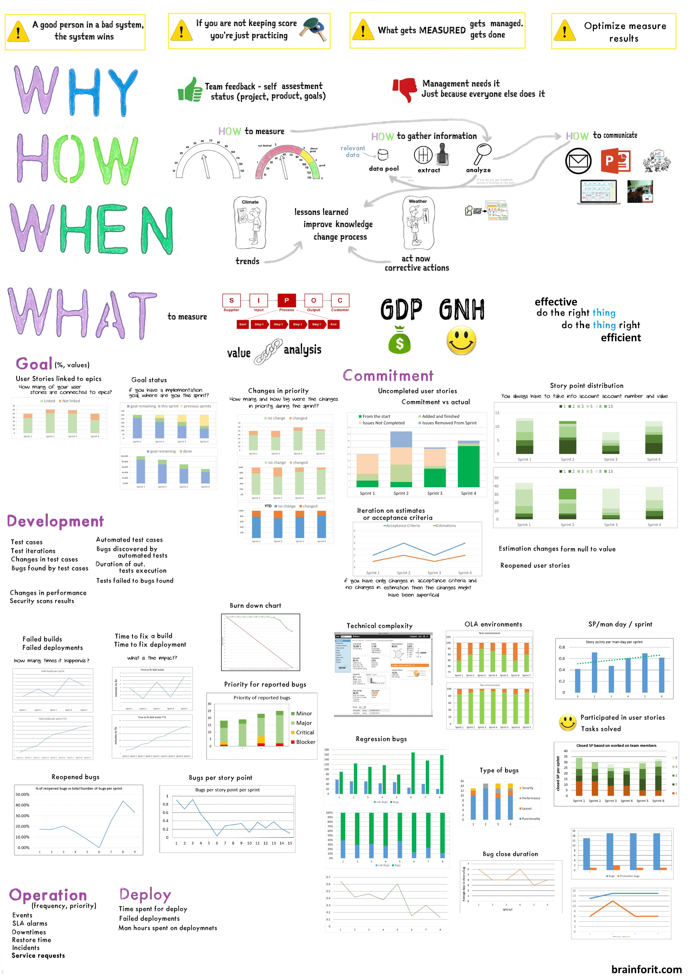
7. Testers have to find bugs.
Testers should be like the headlights of a car
But what to measure?
19. Counting test cases/execution is a good thing
measures.brainforit.com
Notes:
But what to measure?
Some time ago I created this skechnote with around 40 measure that you can use in software development. You have to be really careful what you measure.
For instance: Counting test cases/execution is a good thing.? Counting test cases/execution is the same as counting lines of code per developer. It does not give you any relevant information. It’s a waste of time and resources. Stop thinking in quantity but in quality. For instance, for how many failed automated checks do we find a bug? This is a good metric to measure your automation success and quality.

Slide 28
8. Testers break software
Michael Bolton beautifully said it “testers do not break software, the software is already broken”.
Testers break illusions by providing relevant information.
Notes:
Testers break software… what do you think? Is this true?
Michael Bolton beautifully said it “testers do not break software, the software is already broken”.
Testers break illusions by providing relevant information.

Slide 29
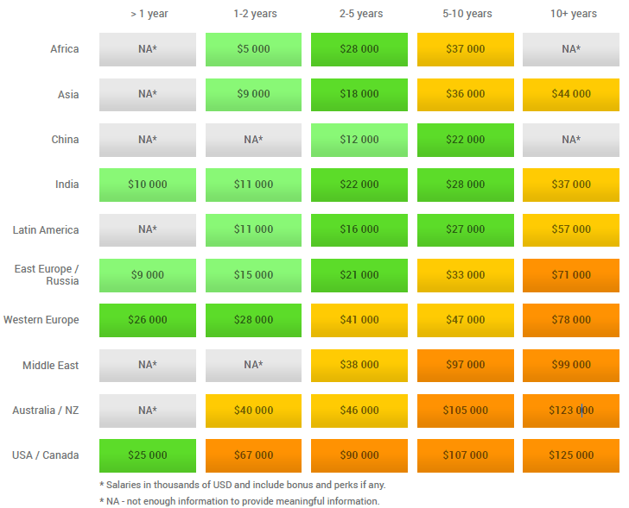

9. Testers with 5 years’ experience are senior.
Increase salary
Notes:
According to the state of testing report there is a clear salary increase the more experience you have.
But let’s not confuse experience with seniority.
Let me clarify this:

Slide 30
9. Testers with 5 years’ experience are senior.
you do something
you do it again
you do it again
you do it again
you do it again
you get hired
2013
today
2018
Can you succeed in any other project, team, technology ?
Notes:
Let’s assume you got hired in 2013 and you do something in the first year, then you do the same thing again, and again, and again
Now it is 2018 . Are you a senior tester?
I believe that you can call yourself a senior tester is you can you succeed in any other project, team, technology ?

Slide 31




10. Don’t have enough time
You have 2 hours to test everything !!!!
GO GO GO GO
I have to work more
This is what I have to test <….>
This is <…> how much time it takes,
What should I do in 2 hours?
Notes:
I Don’t have enough time, I have to work more
Let’s think of a scenario: your boss comes to you and says You have 2 hours to test everything !!!! GO GO GO GO .
You know it takes you at least 6 hours. What do you do?
I tell you what you should do: you should put some fire under his ass !!!
You should come back and state This is what I have to test <….> This is <…> how much time it takes,
What should I do in 2 hours?
Make him feel the pain of being responsible for the decision !!!

Slide 32


11. Testers are the bearers of bad news.
Nothing works
Worst build ever
2clicks and it all crashed
Half implemented
Lost my time waiting for this
we are not done
YET
this is what I believe we should do
Notes:
11. Testers are the bearers of bad news. If you go to every SCRUM and say things like
Nothing works, Worst build ever, 2clicks and it all crashed, Half implemented, Lost my time waiting for this
Your colleagues will start to see you as the bearer of bad news
What you should do is to say: we are not done YET; this is what I believe or need to be done. Knowing what you have to do to get there is a wonderful thing!!!
“we are not done yet!” opens the way for reaching the goal !!!

Slide 33
12. It’s good & ok to test at the end of the Sprint
  12.1 Testing should be done after the de development is done (testers are gatekeepers)
Scrum guide :
7th principle from the Manifesto for agile software development:
“Scrum Teams deliver products iteratively and incrementally, maximizing opportunities for feedback”.
“Agile processes promote sustainable development. The sponsors, developers, and users should be able to maintain a constant pace indefinitely.”.
Notes:
It’s good & ok to test at the end of the Sprint, when working with Scrum. Let’s look at the Scrum guide “Scrum Teams deliver products iteratively and incrementally, maximizing opportunities for feedback”. It does not sound like much of maximizing opportunities for feedback if you test at the end, right? Let’s look also at the 7th principle from the Manifesto for agile software development “Agile processes promote sustainable development. The sponsors, developers, and users should be able to maintain a constant pace indefinitely.”. What kind of pace is it if you test at the end? More of a leap. Testing at the end will never give you the opportunity to maintain a constant pace indefinitely.

Slide 34
13. Testing is what testers do.
  13.1 Testing can be done in isolation by testers
Testing is an activity.
Notes:
13. Testing is what testers do. Of course it is not just what the testers do !!!
Testing is an activity. Many of its aspects are covered by many roles.
For instance, the first automated checks ever implemented were unit tests. They check certain parts of the code.
What a product owner does during the review meeting is to validate the implantation. Verification and validation are 2 key principles in testing.

Slide 35
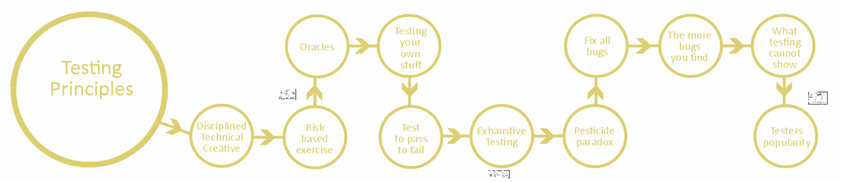
14 Testing is not a structured activity
  14.1 Testing can find all the bugs
  14.2 Production bug: testers have failed

Slide 36
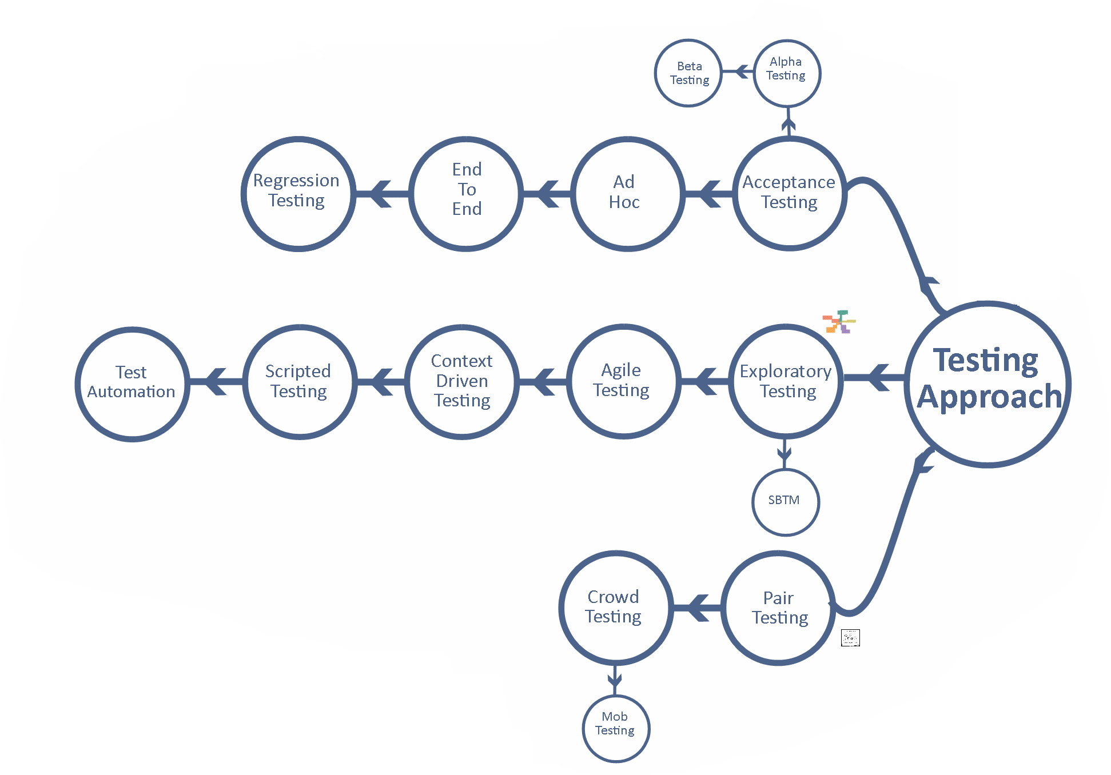
14 Testing is not a structured activity
  14.1 Testing can find all the bugs
  14.2 Production bug: testers have failed

Slide 37
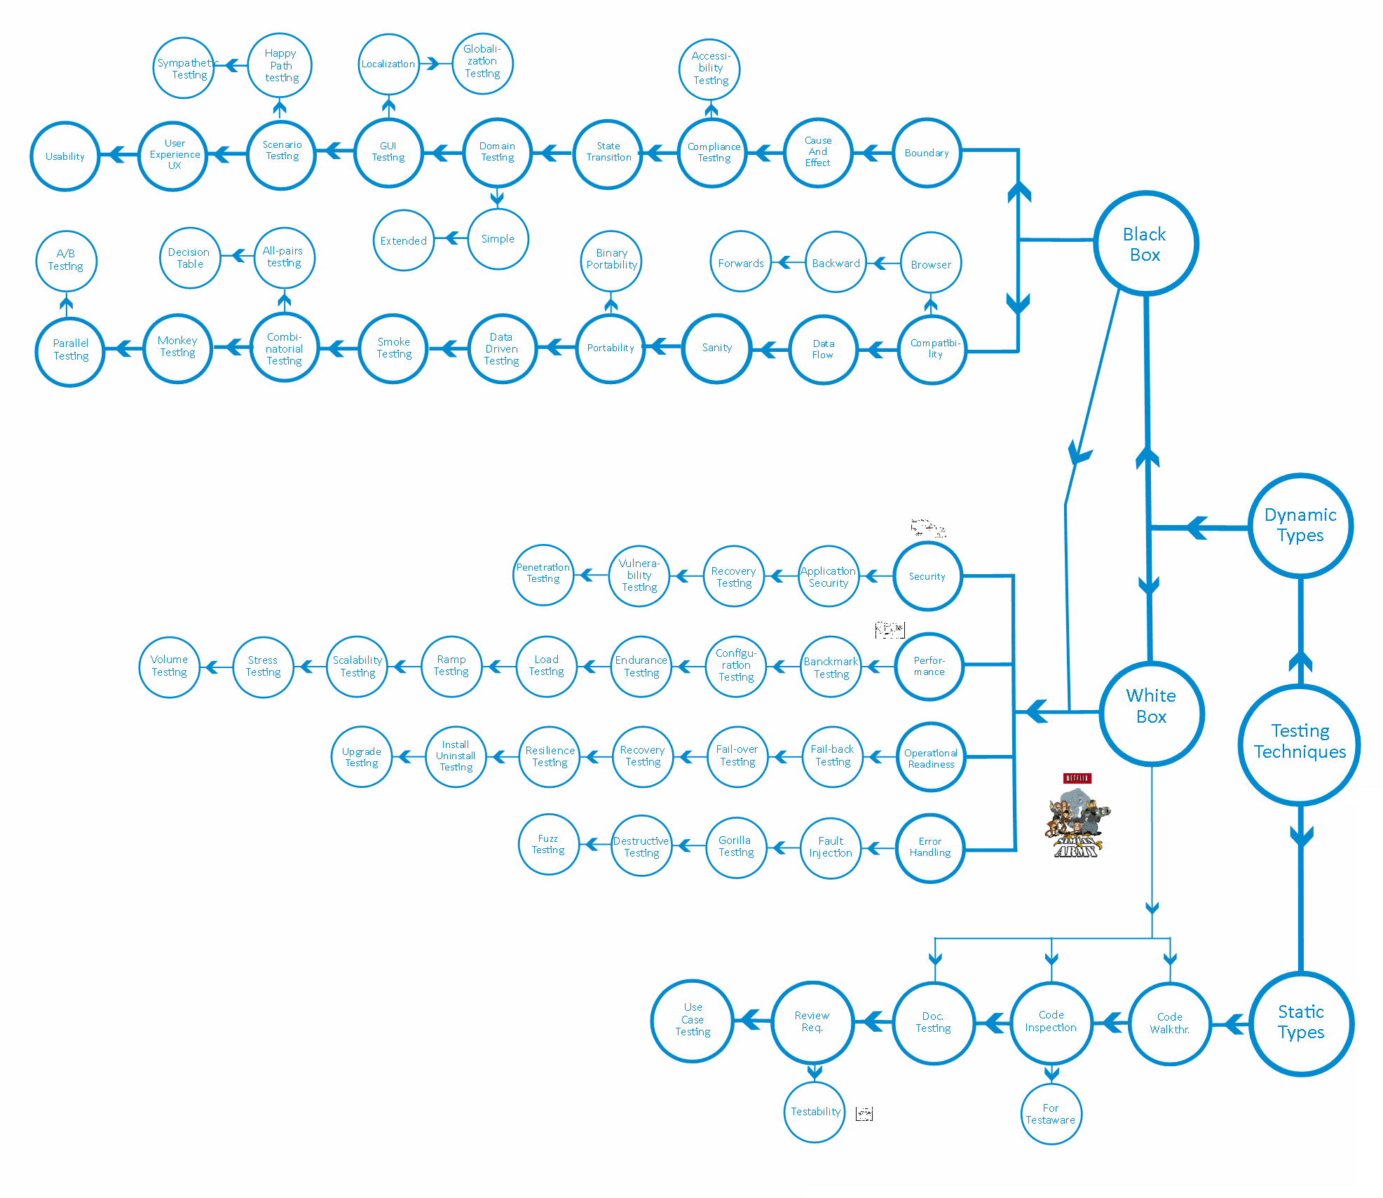
14 Testing is not a structured activity
  14.1 Testing can find all the bugs
  14.2 Production bug: testers have failed

Slide 38

14.1 Testing can find all the bugs
It depends on your GOAL !!!
testing requires people + resources + time
Notes:
Instead of asking what can you do to have no bugs you should ask how fast can fix a bug?

Slide 39
  14.2 Production bug: testers have failed
It depends on your GOAL !!!
Did you had all you needed?
(and asked for it in advance)

Slide 40
20. I am a good tester
14. Testers just have to be smart
It is never enough just to be smart
Know your testing techniques and approaches
Grow your mindset and you leave your project
Notes:
Now we will take 2 misconceptions at once
14. Testers just have to be smart
19. I am a good tester
It is never enough just to be smart (someone has already done this before you)
You need to know your testing techniques and approaches at least
I believe you are a good tester if you leave your project and get in touch with other pears.
Leave your bubble and come out !!! Go to meet ups and conferences..like this one.
I what to share with you my insight of being to a lot of meetups and conferences in this part of the world.
One of two things might happen: you learn what great stuff others are doing and get inspired to do it as well
or, as Ion Creanga says it: “I know I am stupid, but when I look around I get courageous”. And if you start to believe that you can do things better, then you should definitely start doing them. Get involved.

Slide 41

15. Learning testing
  15.1 Certifications are good or bad
  15.2 I will test better next time
Notes:
Do you remember the dentist story from last year?

Slide 42
15.1 Certifications are good or bad
This is testing
Create a system that can evaluate your skills and knowledge
+ a evaluation method
Notes:
It will never be complete !!!
It will never give you a 100% certification !!! No one can say you have the skills for testing. What a certification says is: based on our way of defining testing and our evaluation method you have passed.
What a certification can show is the commitment someone has in order to understand the system of certification and take a exam.
Usually we think of certifications as a expert view from a 3rd party…. It might be a expert view but it is always a impartial view.
By using certification as hireling criteria we recognize that we are not capable of evaluating if someone is good or not for the job.

Slide 43
  15.2 I will test better next time
Strategies
Techniques
Practices
Result

Slide 44
  15.2 I will test better next time
Assumptions
Strategies
Techniques
Practices
Result

Slide 45
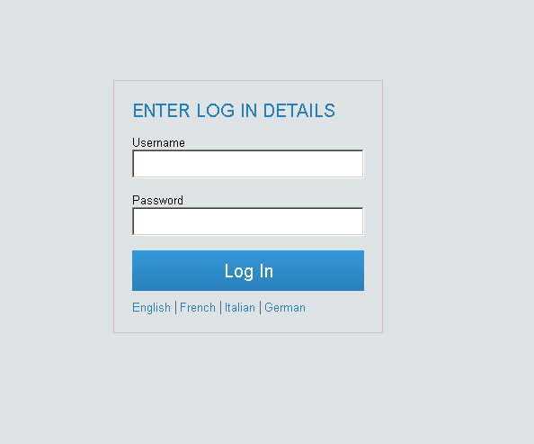
18. Testing is an analytical activity.
  18.1 In order to properly test you need test cases
Testing Challenge #10 - BUG HUNT
10
11
12
13
14
15
16
17
18
20
21
1
2
3
4
5
6
7
8
9
Bugs
testingchallenges.thetestingmap.org
Notes:
16. Testing is an analytical activity.
What do you think? Is testing something close to mathematics? Or more on the creative side?
I have site testingchallenges.thetestingmap.org where you can find some small scenarios where you have a clear testing mission.
Once of the challenges is to identify all the bugs from a log in age.
How many times do you think someone that build test cases in advance manage to find all the bugs?
At the most where 8 bugs!!!! Based on test cases and scripts.
If testing is so analytical, how come you cannot created test cases or test scripts that will find all the bugs?
What do you think?

Slide 46
  18.1 In order to properly test you need test cases
Test Case
Preconditions
Steps
  Action
  Data
  Expected results
Post conditions
testability
Purpose of documentation
  Review
  Validation
  Execution tracking
  Reusability
  Evidence of activity
  Execution by anyone

Slide 47

19. What is software testing
(g,r,f,c,d,t,p) = testing
        goals
        resources
        functionality
        configuration
        data
        time
        people (knowledge, skills, interactions)
ksi
+testability

Slide 48
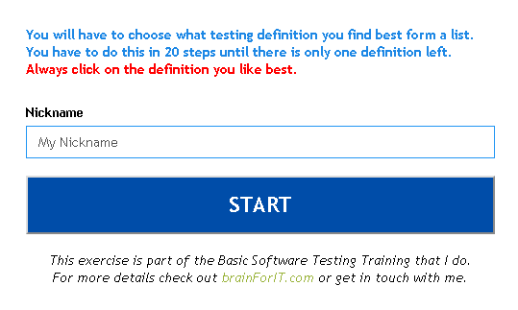
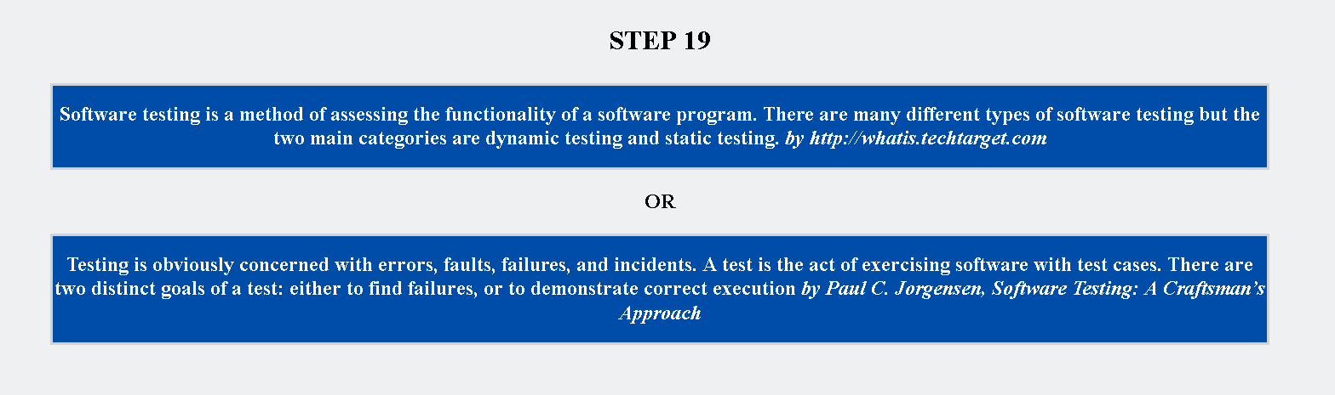
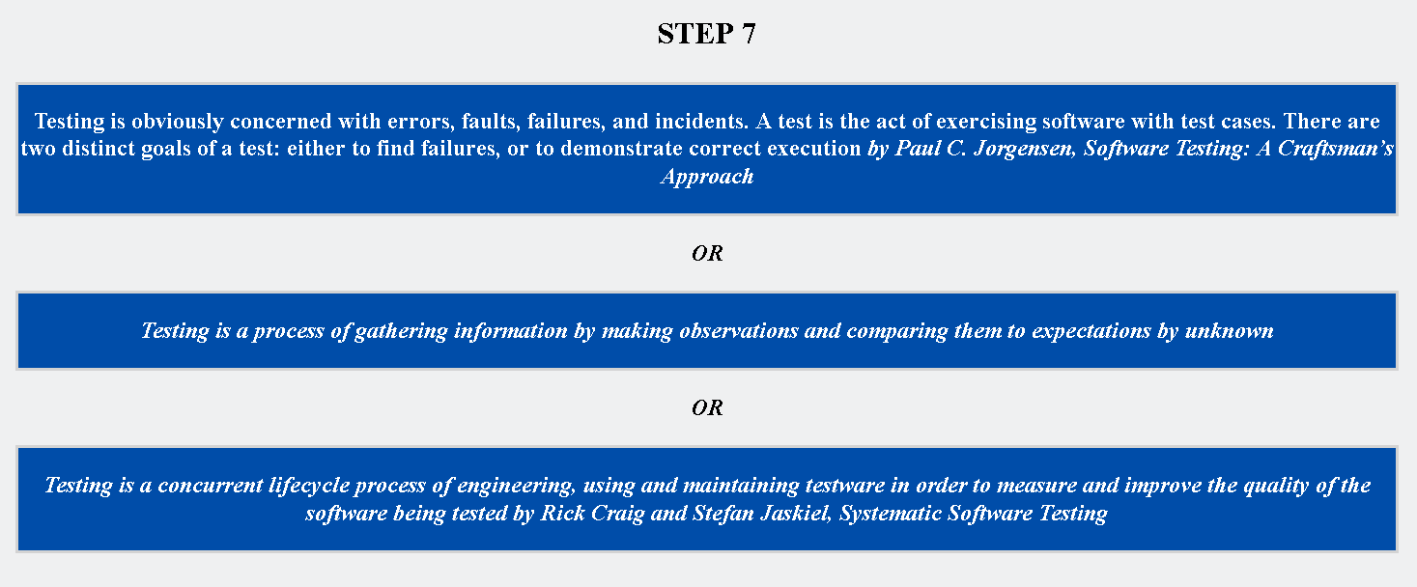
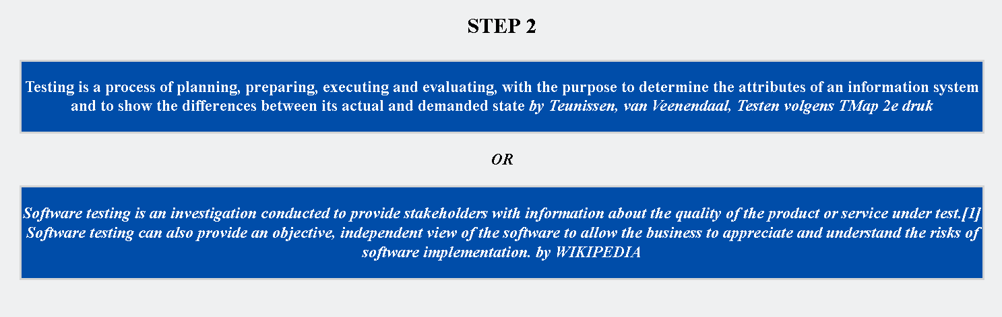
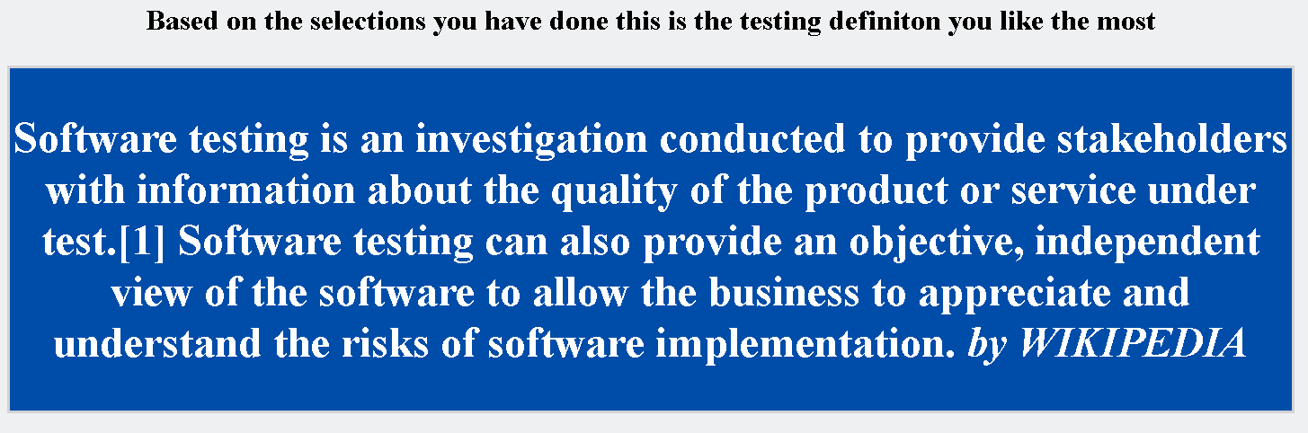
19. What is software testing
(g,r,f,c,d,t,p) = testing
……………………………20 steps……………………………………………
testingis.brainforit.com
Notes:
TESTINGIS

Slide 49

19. What is software testing
Quality Assurance
Context driven
Agile Testing
Control
Factory
Test Driven
Analytical
schoolsoftesting.brainforit.com
Notes:
18. What is software testing is greatly influenced by how you perceive software testing.
Have you heard about schools of testing?
Schools of testing are ways of thinking about testing. I identified 7 big ways of thing about testing.
And if you are wondering if this house exists the answer is yes., It is real. You can see on top it has a speaker and it tells the story of each school if you ring the door bell.
So how can you look at testing: you can see it as Analytical , if this is the case then testing can be turned into a factory where the focus in mainly on cheap labor, low skill workers. If this the case then you need some for of process Control. Then it is the view that testing is quality assurance, which you know now it is not true. And afterwards we have the context driven school of though, Agile testing and test driven.
There is a lot to talk about these, but one thing is clear: your view of testing will fall under one of these categories and will greatly influence how you see software testing.

Slide 50
19. What is software testing
You have good choices and other choices.
Testing is a good choice!

Slide 51

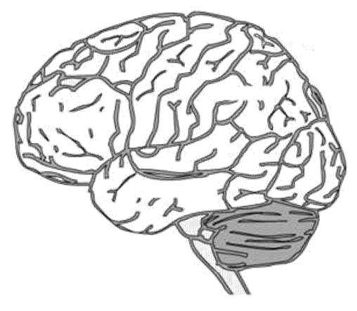
What should be in the mind of a tester?

Slide 52
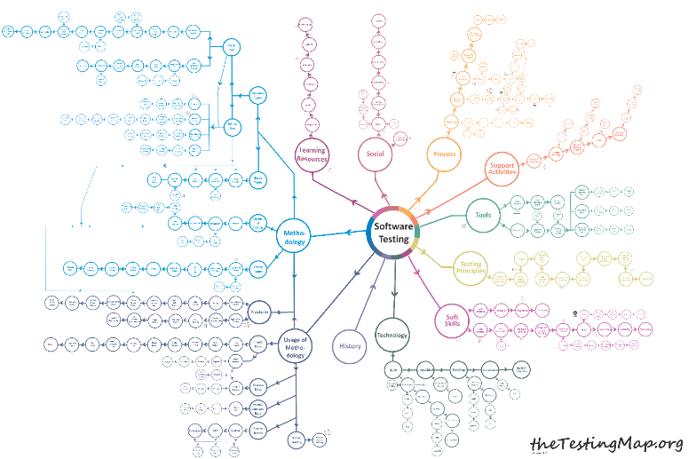
What should be in the mind of a tester?
Logic
Critical Thinking
Habits
Creativity
System 1
Intuition
Provide stakeholders with valuable information
System 2
Social skills
Growth mindset
Experience
Notes:
What should be in the mind of a tester?
Well first there is some testing knowledge, like the testing I presented earlier, but you need also to have Logic, Critical Thinking, Creativity, Intuition, Social skills, you have to be aware of you Habits, how your mind works and you need a growth mindset.

Slide 53
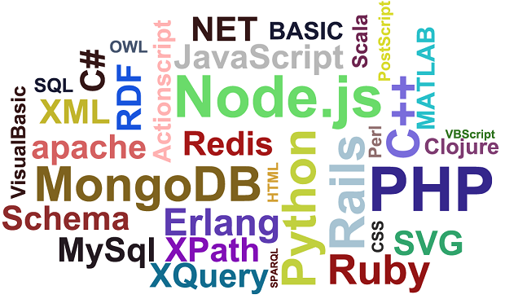
17. Testers are unsuccessful developers
Logic
Logic
Critical Thinking
Critical Thinking
Habits
Creativity
Habits
Creativity
Intuition
System 1
Intuition
System 2
System 1
Social skills
System 2
Social skills
Growth mindset
Growth mindset
Experience
Experience
Developer
Tester
Notes:
And now we come to the last misconception: 15. Testers are unsuccessful developers
If you have all the skills that I mentioned earlier, all you need is the technical knowledge…
But you have these skills only if you are a processional tester…

Slide 54
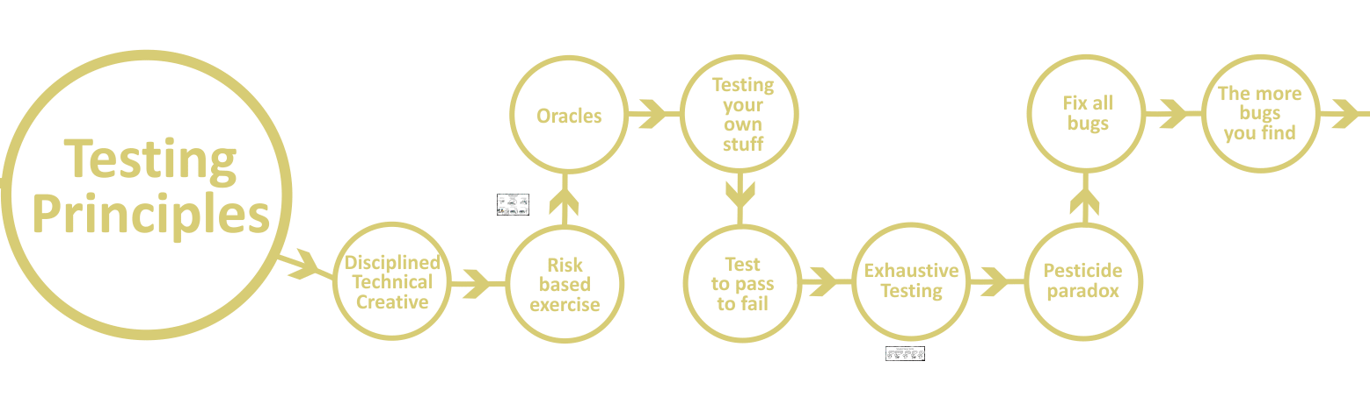
17.1 Testers should not learn how to code

Slide 55



Claudiu Draghia
BrainForIT.com
Claudiu@BrainForIT.com
@claudiu_dra
ANY
STIONS?

Slide 56
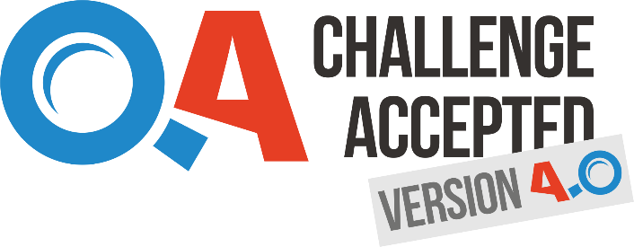

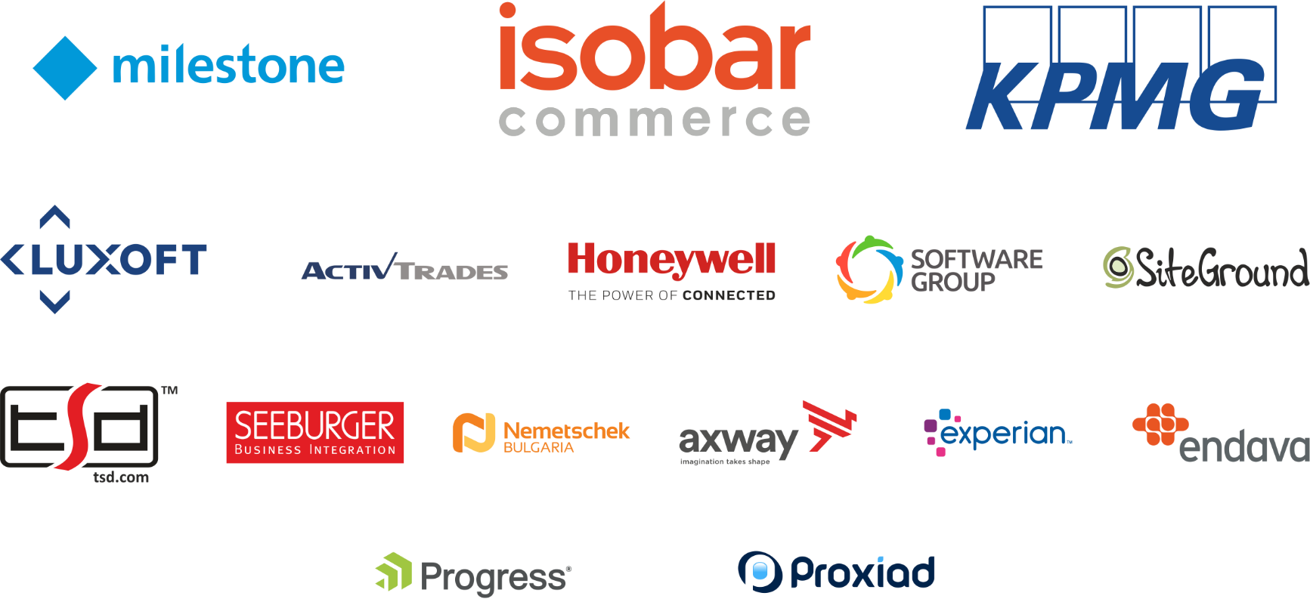
www.qachallengeaccepted.com
info@qachallengeaccepted.com
#qachallenge
thanks to our sponsors:

Slide 57
15. Learning testing
  15.1 Certifications are good or bad
  15.2 I will test better next time
science
knowledge
time
Notes:
A paradigm is a idea, something accepted by everyone as the truth.
Until a experiment proves that the paradigm is not right. A revolution is under way to find a new set of rules.
The structure of scientific revolution 1974
Copernican Revolution
Kuhn highlight a new methodology that focuses on
Articles (from magazines or blogs as we have right now), Personal impression fo science people; Correspondence and discussions (letters and focums)
“Manuals” contain static knowledge
The main factor is not the science person but the science community
A school of though has different paradigms.

Slide 58

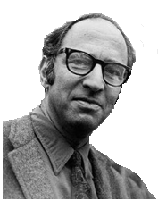
15. Learning testing
  15.1 Certifications are good or bad
  15.2 I will test better next time
Normal
science
Paradigm
Change
Model Drift
Model Revolution
Model Crisis
Thomas Khun
Notes:
A paradigm is a idea, something accepted by everyone as the truth.
Until a experiment proves that the paradigm is not right. A revolution is under way to find a new set of rules.
The structure of scientific revolution 1974
Copernican Revolution
Kuhn highlight a new methodology that focuses on
Articles (from magazines or blogs as we have right now), Personal impression fo science people; Correspondence and discussions (letters and focums)
“Manuals” contain static knowledge
The main factor is not the science person but the science community
A school of though has different paradigms.

